Slide 1

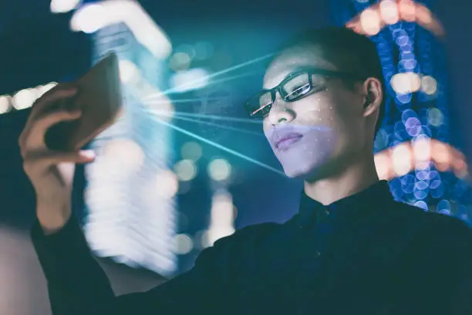
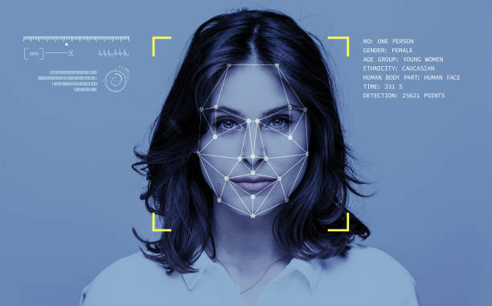

Face Detection
2nd ECE
Digital Image processing project
Under supervision of: Dr. Azhar

Slide 2
Group Members
01
Aya Mahmoud Ali Ali “section 2”
02
Basma Ali Ibrahim Ali “section 2”
03
Fatma Elsherief Aref Mohamed “section 4”
04
Nada salah Mahmoud Ahmed “section 5”
05
Reem Elsayed Mohamed Elsayed “section 2”

Slide 3
Group Members
06
Rokaya Waheed Mohamed Ibrahim “section 2”
07
Shahd Ahmed Ali Mohamed “section 3”
08
Shams Mohamed Gamal Mahmoud “section 2”
09
Shrouk Ibrahim Ahmed Zaki “section 2”

Slide 4
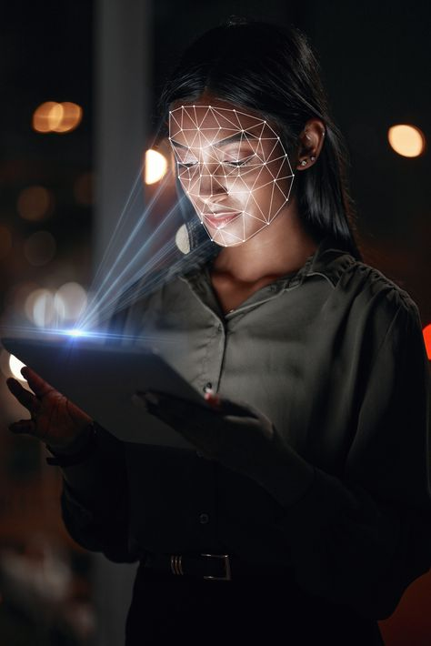
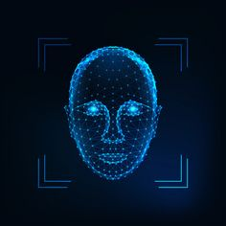
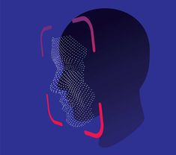
Table of contents
01
03
02
05
04
06
Introduction
Methodology
Objective
Future prespectives
Results
Refrences

Slide 5
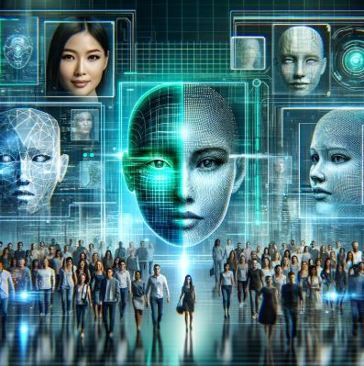
01
Introduction

Slide 6
In recent years, face detection technology has become a crucial component in various applications such as security systems, biometric authentication, and human-computer interaction. This project focuses on the development of a face detection application using MATLAB

Slide 7
02
Objective

Slide 8
The main objective of this project is to design and implement an efficient system capable of detecting human faces in digital images without relying on built-in face detection functions. Instead, the approach is grounded in fundamental image processing techniques developed and coded from scratch. The objective of the project is to explore the core principles behind face detection by designing algorithms that analyze pixel intensity patterns, geometrical features, and edge information to identify facial regions within an image.

Slide 9
03
Methodology

Slide 10
Start
Read & preprocess image
Convert image color space
This project implements a custom face detection algorithm in MATLAB, avoiding built-in face detection functions. The methodology consists of several key stages, from preprocessing to face validation and result display.
Skin detection
Region analysis
More regions?
yes
No
Face filtering criteria
Display results
End

Slide 11

01
Image Input and Preprocessing
The input image is read using imread() and resized to a standard size of 300×300 pixels to normalize input dimensions and reduce computational complexity.
Contrast enhancement is applied using imadjust() along with stretchlim() to improve visibility of skin regions.

Slide 12

02
Color Space Conversion (YCbCr)
The image is converted from RGB to YCbCr color space.
The chrominance channels Cb (blue difference) and Cr (red difference) are extracted to isolate skin tone regions. This is based on the fact that human skin tones fall within a specific range in the YCbCr space

Slide 13
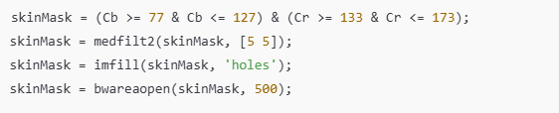
03
Skin Region Detection
A binary mask is created by thresholding Cb and Cr to isolate probable skin pixels.
Morphological operations are applied:
Median filtering smooths the mask and reduces noise.
Hole filling ensures skin regions are solid.
Area filtering removes small objects that are unlikely to be faces.

Slide 14

04
Region Analysis and Candidate Filtering
regionprops() is used to find bounding boxes and areas of skin regions.
Each candidate region is extracted and evaluated based on:
Aspect ratio: Must fall between 0.4 and 2.5.
Image contrast: Standard deviation of grayscale intensity must be greater than 25 (to filter out flat or irrelevant areas).

Slide 15

05
Face Confirmation and Display
Bounding boxes are drawn around the valid face candidates.
A face counter tracks the total number of detected faces.
The image is displayed with annotations for user visualization.

Slide 16
04
Results

Slide 17
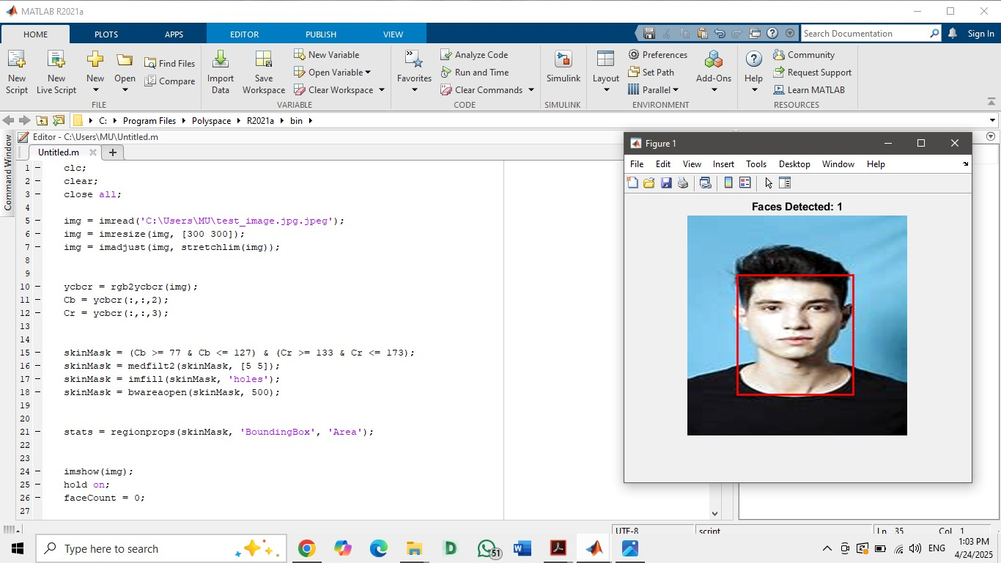
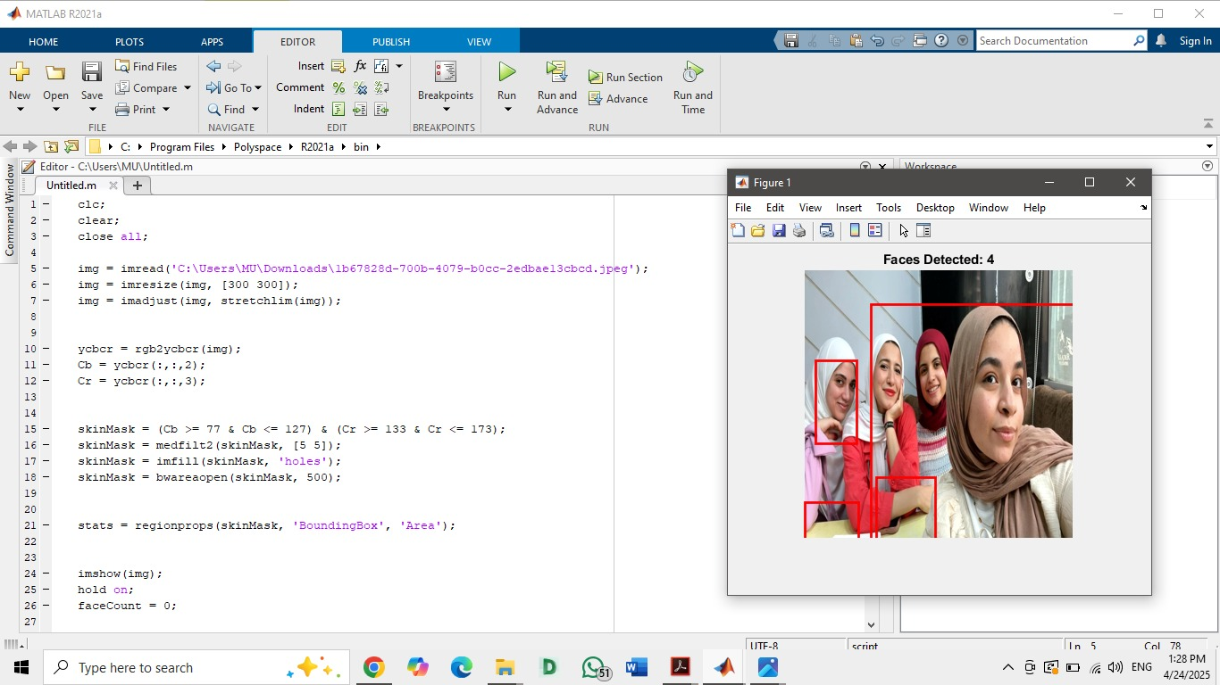

Slide 18
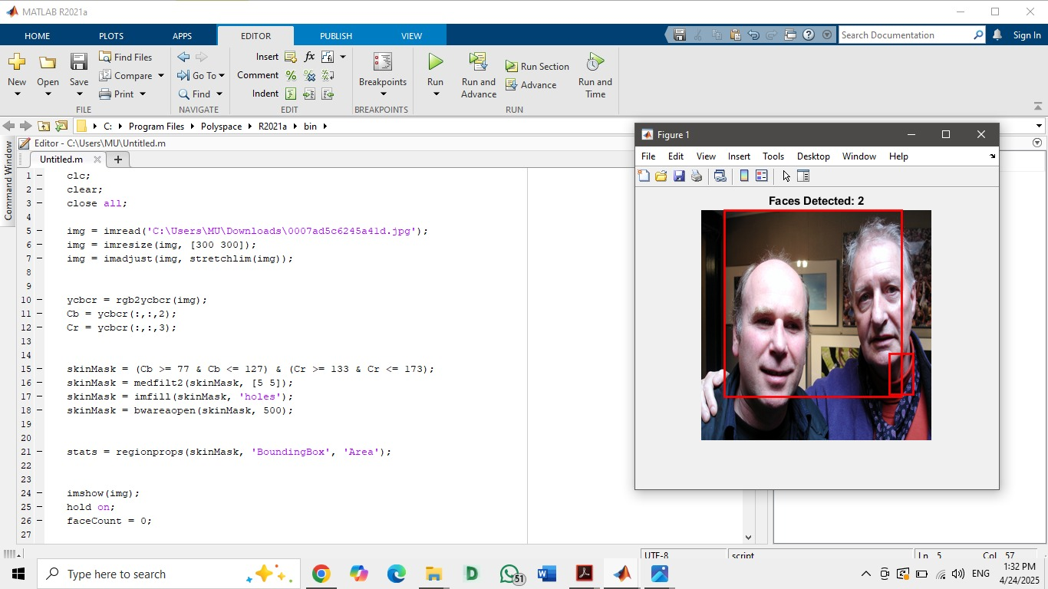
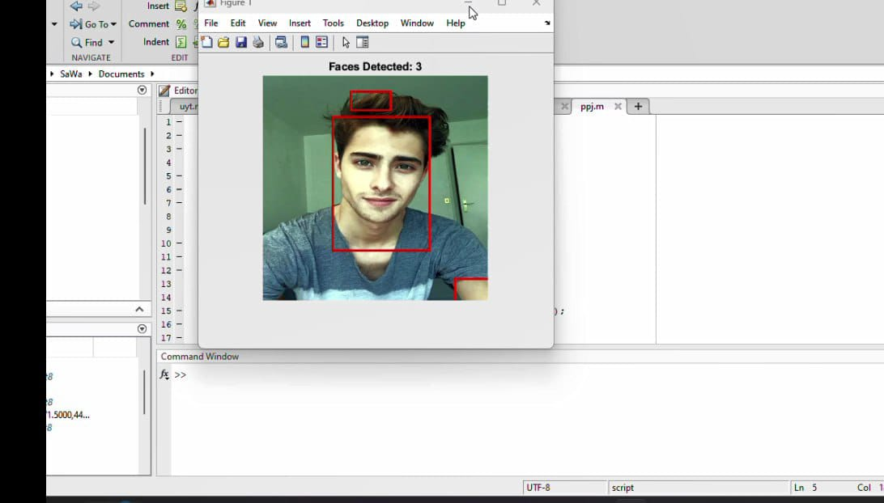

Slide 19
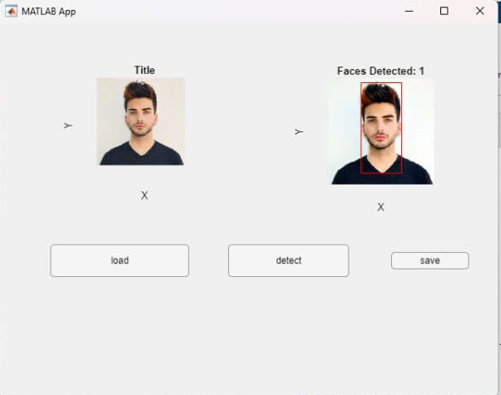
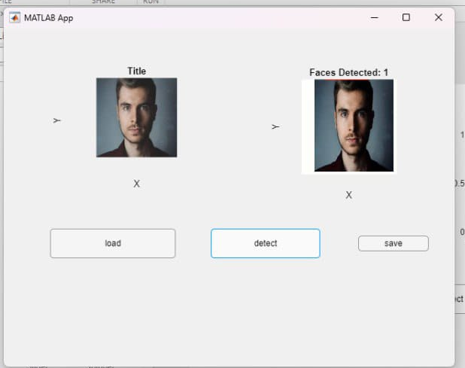

Slide 20
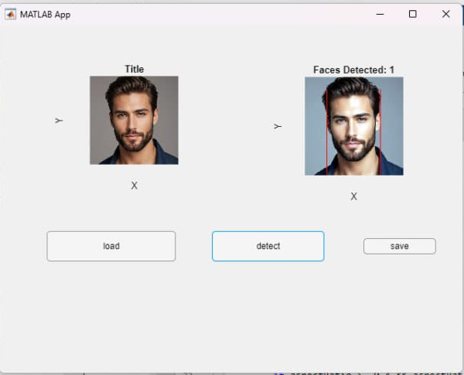
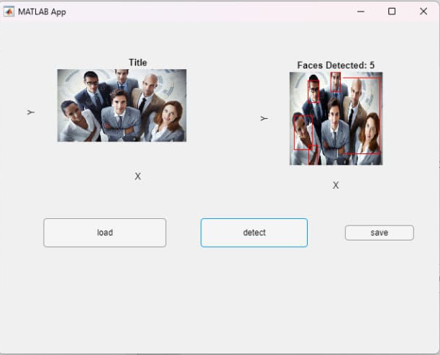

Slide 21
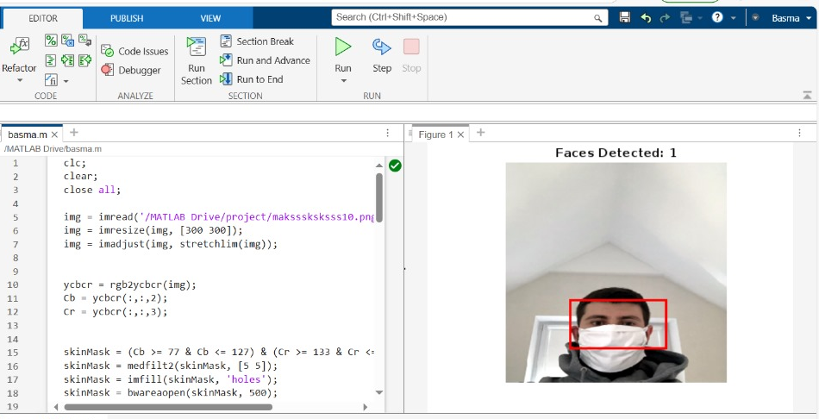

Slide 22
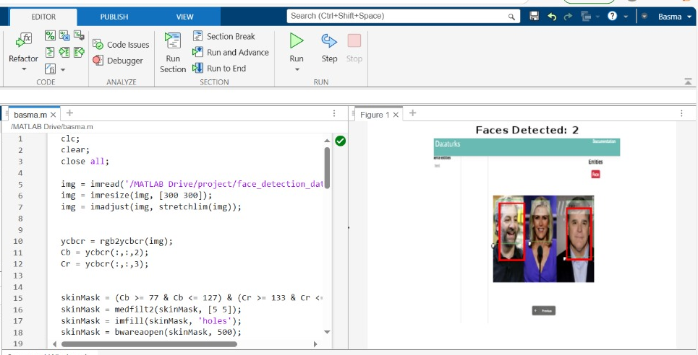

Slide 23
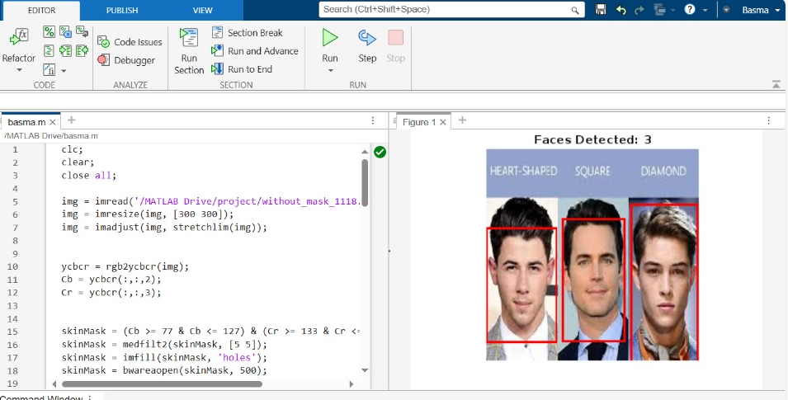

Slide 24
05
Future prespectives

Slide 25
Implementing Face recognition
While this project currently focuses on detecting faces in an image using custom, non-built-in functions, a natural and powerful extension is face recognition —the ability not just to detect a face, but to identify or verify the individual.
Step 1: Dataset Creation
Collect and store face images of known individuals.
Use multiple images per person, taken under varying conditions (lighting, pose, expression) to improve accuracy.
Step 2: Feature Extraction
After a face is detected, extract a feature vector from the face using one of the following:
Histogram of Oriented Gradients (HOG)
Local Binary Patterns (LBP)
Principal Component Analysis (PCA)
Deep learning embedding

Slide 26
Step 3: Face Matching
Compare the extracted feature vector of the detected face with vectors stored in the database.
Use similarity metrics like Euclidean distance or cosine similarity to find the closest match.
Step 4: Decision Making
If the closest match is below a defined threshold, the face is recognized.
Otherwise, it may be marked as "unknown" or rejected.

Slide 27
06
Refrences

Slide 28
MathWorks Documentation “MATLAB Image Processing Toolbox” https://www.mathworks.com/help/images/
Pitas, I. (2000). Digital Image Processing Algorithms and Applications. Wiley.
Gonzalez, R. C., & Woods, R. E. (2018).
Digital Image Processing (4th ed.). Pearson.
Face Detection using Skin Color Model –
Hsu, R.L., Abdel-Mottaleb, M., & Jain, A.K. (2002).Face detection in color images. IEEE Transactions on Pattern Analysis and Machine Intelligence, 24(5), 696–706.
Turk, M., & Pentland, A. (1991).
Eigenfaces for recognition. Journal of Cognitive Neuroscience, 3(1), 71–86.

Slide 29
Thanks!

